Slide 1
Numerical Solution of ODEs using Taylor series
Course Instructor
Engr. Zoobia Zeeshan
zoobiazeeshan.bukc@bahria.edu.pk

Slide 2

Taylor Series
Taylor Series is the series which is used to find the value of a function.
It is the series of polynomials or any function and it contains the sum of infinite terms.
Each successive term in the Taylor series expansion has a larger exponent or a higher degree term than the preceding term.
We take the sum of the initial four, and five terms to find the approximate value of the function but we can always take more terms to get the precise value of the function.

Slide 3
Taylor's Theorem helps in approximating complex functions but the estimates generated by it may harbor errors due to several factors:
Truncation of the series: This happens when the infinite series in a Taylor's Theorem series is limited to a finite number of terms.
Choice of point of approximation: This is another factor that can significantly affect the approximation's quality.
Nature Of the Function : The nature of the function you are approximating affects how well the Taylor series works. Some functions are easy to approximate using a Taylor series, while others are harder due to certain behaviors. These behaviors can lead to larger errors in the approximation.
There are a few types of functions where Taylor series might not work well, or where you might need to include many terms to get an accurate approximation:
a) Functions with Rapid Changes (Steep Slopes or Sharp Features)
Some functions change very quickly over a small range of xxx. For example, the exponential function exe^xex grows very rapidly as x increases, or functions like sin⁡(x) and cos⁡(x) oscillate frequently.
Issue: For such functions, the Taylor series might need many terms to accurately capture their behavior, especially if you are trying to approximate the function at points far from the center of expansion (point a).
Example: If you are trying to approximate epowerx around x=0, you might get a good approximation near x=0, but as you move farther away, the approximation gets worse unless you include more terms from the series.

Slide 4
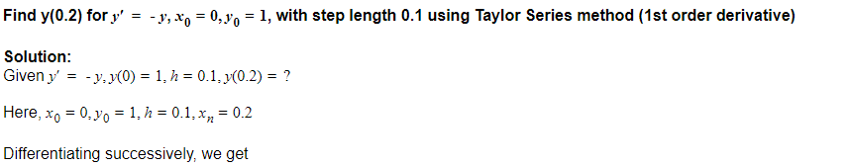
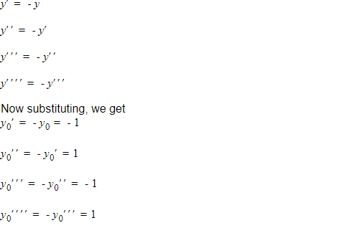
Example

Slide 5
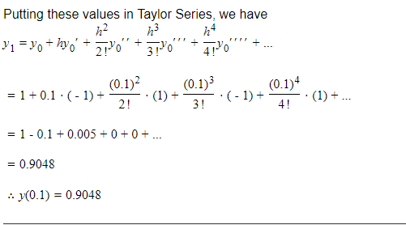
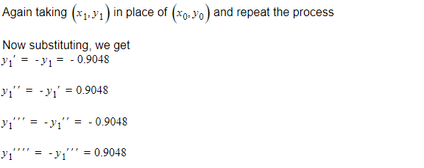

Slide 6
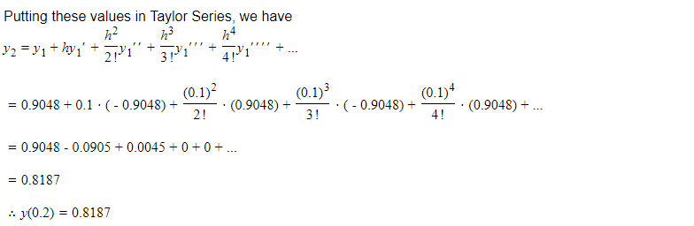

Slide 7
Example
Solve dy/dx = x+y, by Taylor Series method start from x = 1 , y = 0 and carry to x = 1.2 with h = 0.1
 | Approximate Answers
y(1.1) | 0.1103
Y(1.2) | 0.2428

Slide 8
Applications of Taylor Series
In Economics, Taylor's Theorem often takes center stage. The Taylor series is extensively used for its easy-to-use approximations for complex functions. For example, in macroeconomics, the Taylor Rule is promulgated which guides central banks in setting the nominal interest rate. This rule uses a first-order Taylor series approximation around an equilibrium level.

Slide 9
Exercises
Question # 01:
Find y(0.2) for y′=y, x0=0,y0=1, with step length 0.1 using Taylor Series method
Question # 02:
Use Taylor Series method to solve the dy/dx = 2y+3e^x with initial conditions xo = 0 and yo =1. Find approximate values of y for x = 0.1 and x =0.2

